Slide 1

House Simple
“…this simple"
Khaled Al Najjar
Farukh Jabeen
Saad Moinuddin
Bhavnil Patel
Anna Sak
Chongli Zhao

Slide 2

What Is My Home Worth?
How do you determine the value of your home?
How much money is your home worth right now?
How much should you list your home for?
2
Notes:
Edit business

Slide 3
Approach
Collect historical data on home sales in Southern Ontario
Houses in the City of Mississauga
Identify variables that affect home prices
Dependent:
Adjusted home price
Independents:
Rooms
Home style
Distance from points of interest
Model the Data
OLS Algorithm
3

Slide 4
Methodology
Collect Data
Categorize relevant variables
Adjust for Real House Value today (inflation)
Construct relevant variables
Distance To Go
Distance To Hospital
Seasonality
Accommodate the OLS function for modelling
4

Slide 5
Variables
DEPENDENT VARIABLE
Market Value
INDEPENDENT VARIABLES
Type of Property
Season
Number of washrooms
Number of Bedrooms
Distance to Go
Distance to Hospital
Geographical Coordinates
5

Slide 6

HYPOTHESIS
“If a home is located within a closer vicinity of a Go Station and Hospital while also maintaining more desirable features, such as more rooms and washrooms, then we expect to see a higher market value for that home”

Slide 7
Analyzing The Data
Is there a relationship between key independent variables and the dependent variable?
Display visualizations of relationships between variables upon which hypothesis is based

Slide 8
8
Model Formulation
Orderly Least Squares (OLS)
Split the data into Test and Train
Fitting the model
Predictions

Slide 9
Results
Accuracy score and number of correct predictions
Evaluate model performance by calculating the residual sum of squares and variance score
Using Scatterplot to see the distribution of test and predicted values.
Plot a histogram of residuals to see if it’s normally distributed.

Slide 10
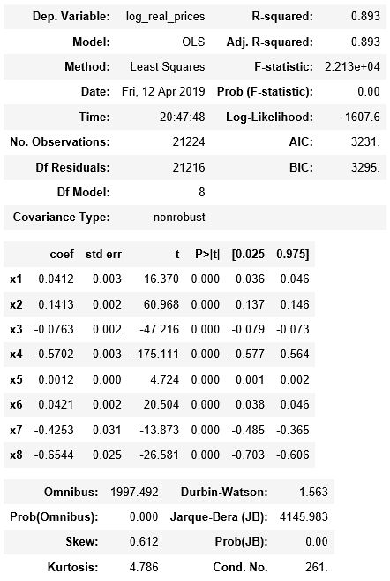
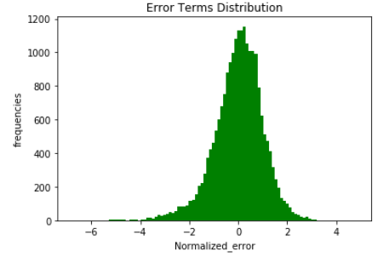
Results
Highlight:
1: Explanatory power: Higher R squared
2. Independent variable joint significance: Higher F test
3. Independent variable individual significance: Higher individual T test
4. Distribution of error term: Modestly skewed and leptokurtic

Slide 11

Further Development and Limitations:
Further Development
UI Development
Real time analytics
Length of time listed
Optimize model for each location
Implications of bank interest rate
Limitations
Square footage
Age of home

Slide 12

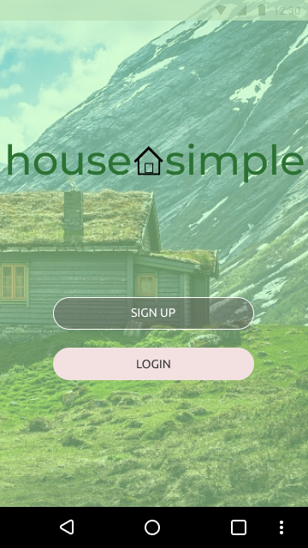
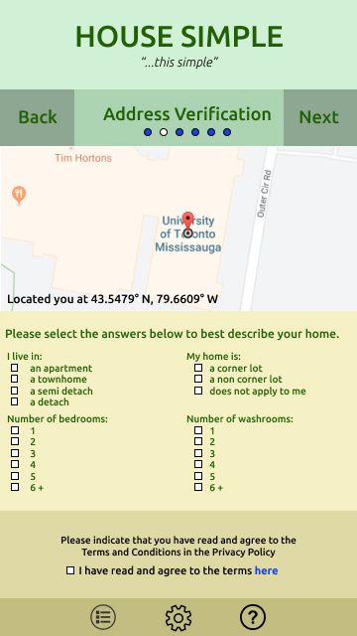
Concept and Production

Slide 13
Concept and Production
Product and slogan are easy to remember
UI is user friendly and clutter free
Integration with Google Maps
Easily attainable data for categorical variables

Slide 14

Thank You!

